Slide 1
Field Data Submission (FDS) Part of the GEIS funded Syrian Refugee project
Walter Reed Biosystematics Unit
Luke Mitchell

Slide 2
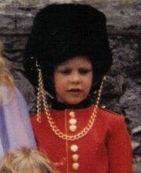
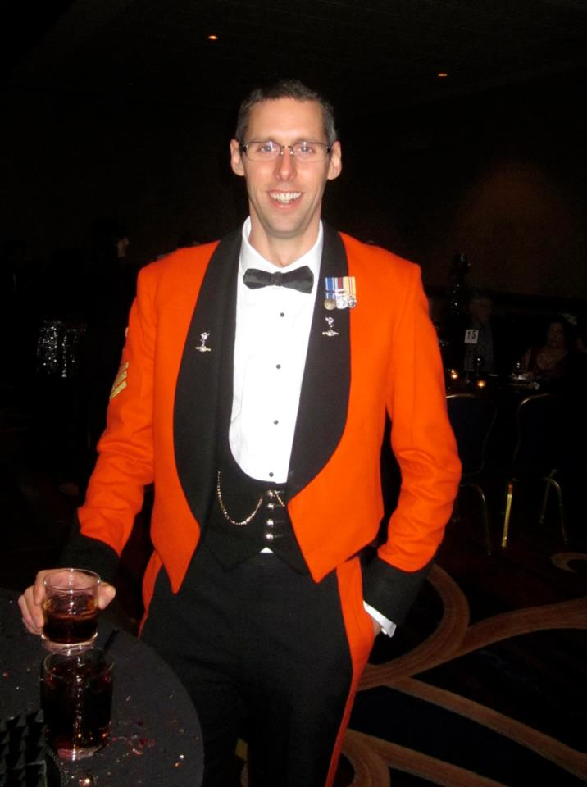
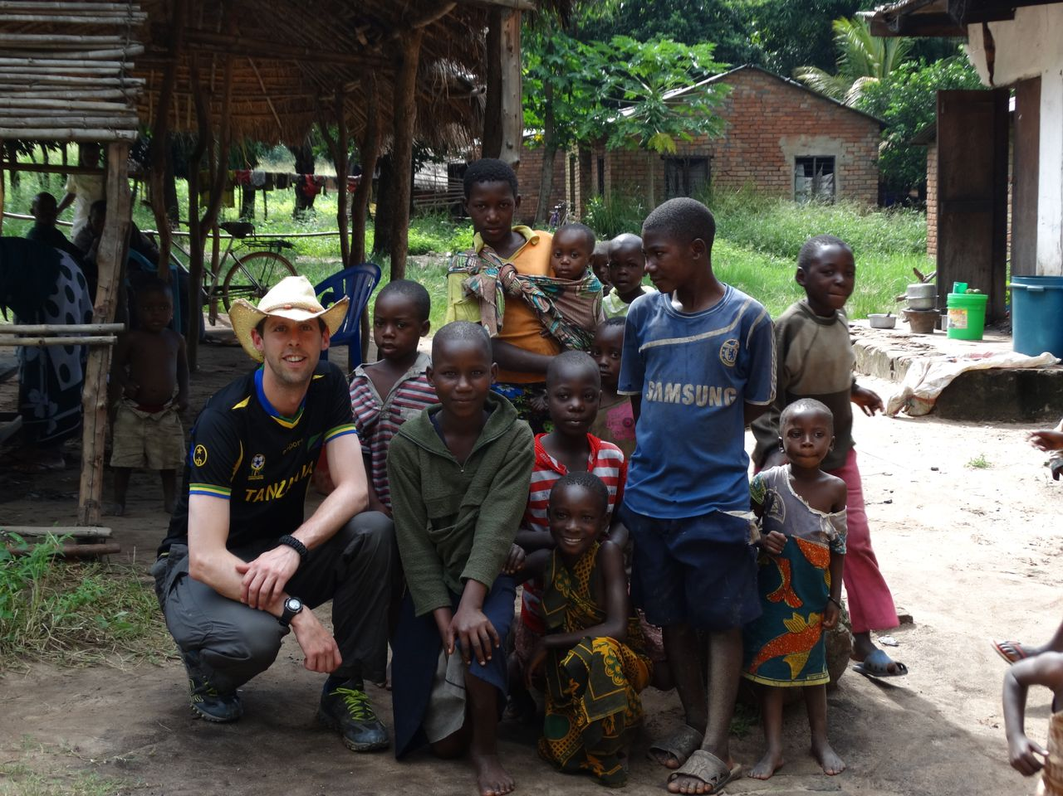
Mr Luke Mitchell – The Designer
Consultant.
Currently employed by WRBU and SI as a technical research assistant.
15 years British Army, Royal Signals as a telecommunications specialist, project and information manager.
Collections in Africa, US and Europe.

Slide 3
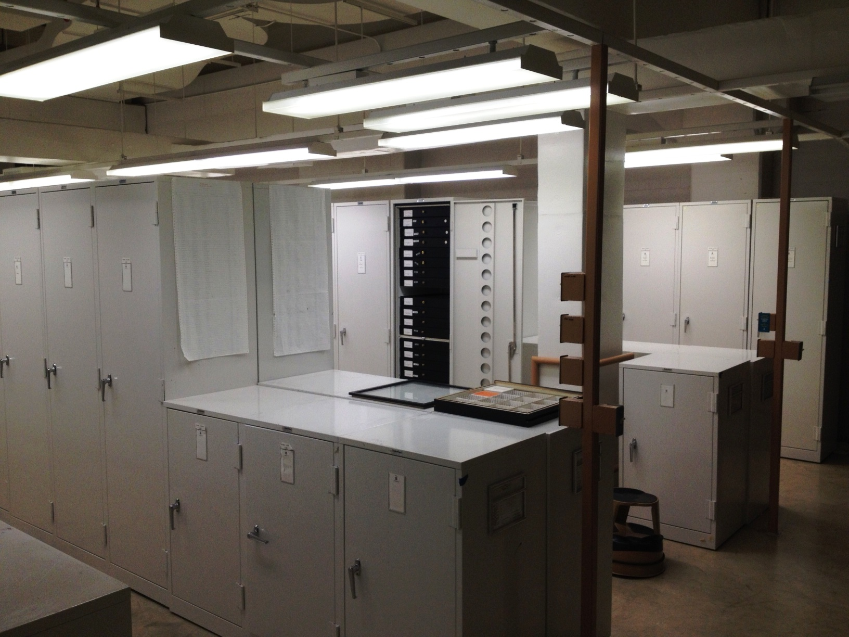
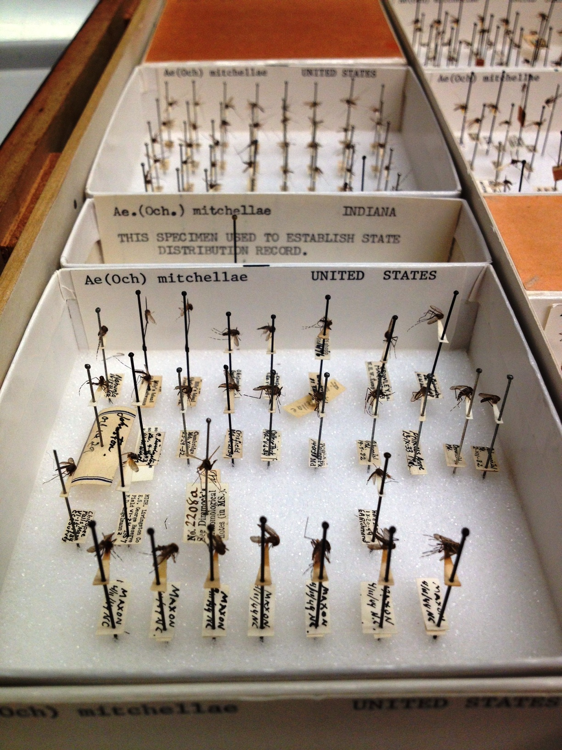
Project focus – Syrian refugee project
Associated specimen data (georeferences, locality and habitat variables) are critical to modern biosurveillance programs, allowing development of spatially and temporally informed vector borne disease risk assessment.
It’s more important than the specimen !
So they give you a bit of paper to record it all on…
in a rainforest !

Slide 4
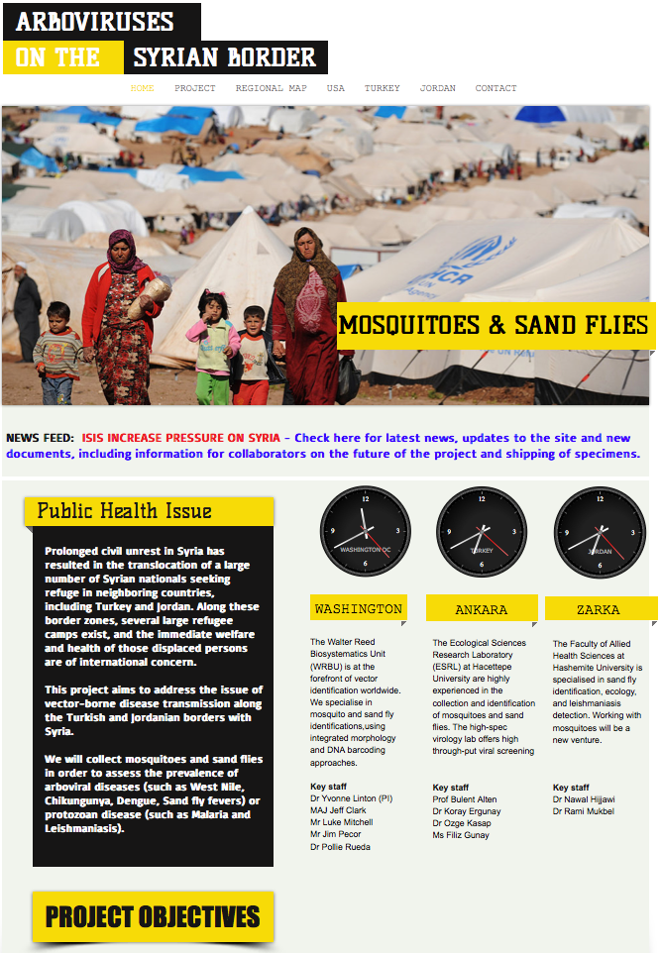
Project focus – Syrian refugee project
The Syria project: The collection of Mosquitoes, Sand Fly, pathogens and viruses in Turkey and Jordan, on the borders of Syria.
Current situation
Project protocols
Collections
Analysis
Publication/Dissemination

Slide 5
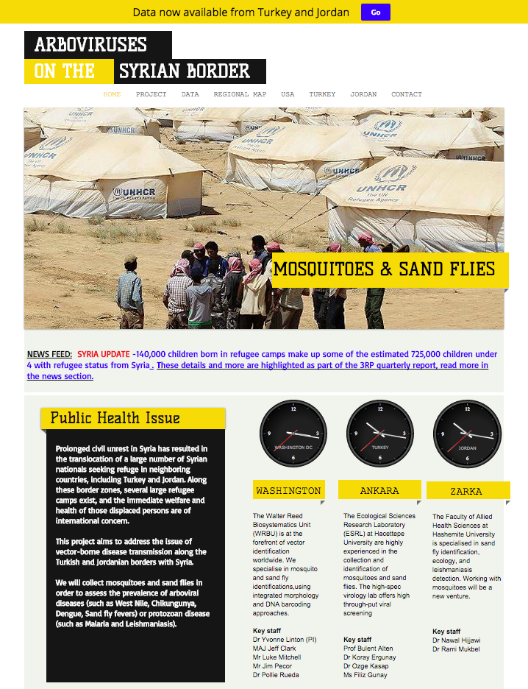
Project focus – Syrian refugee project

Slide 6
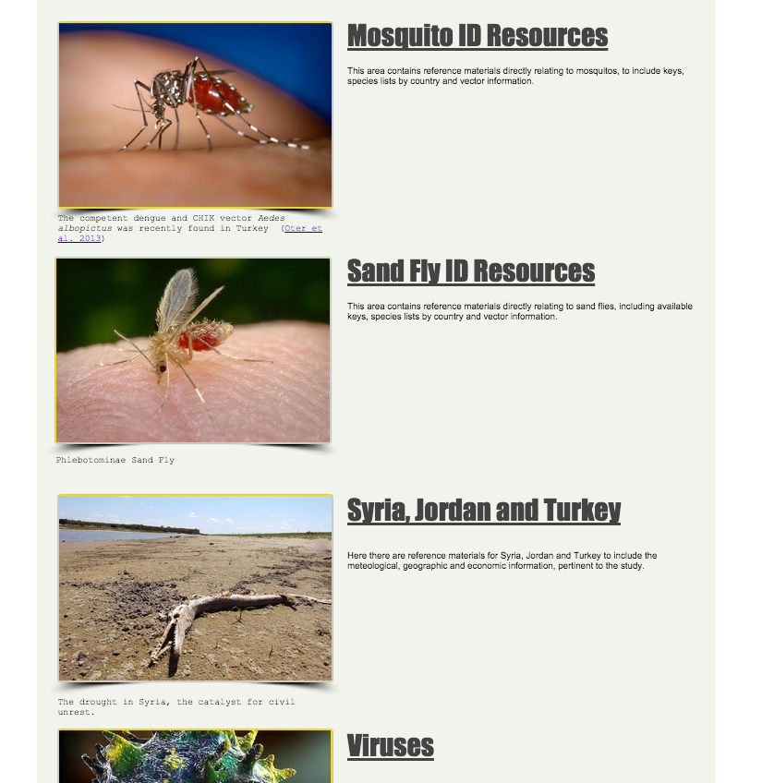
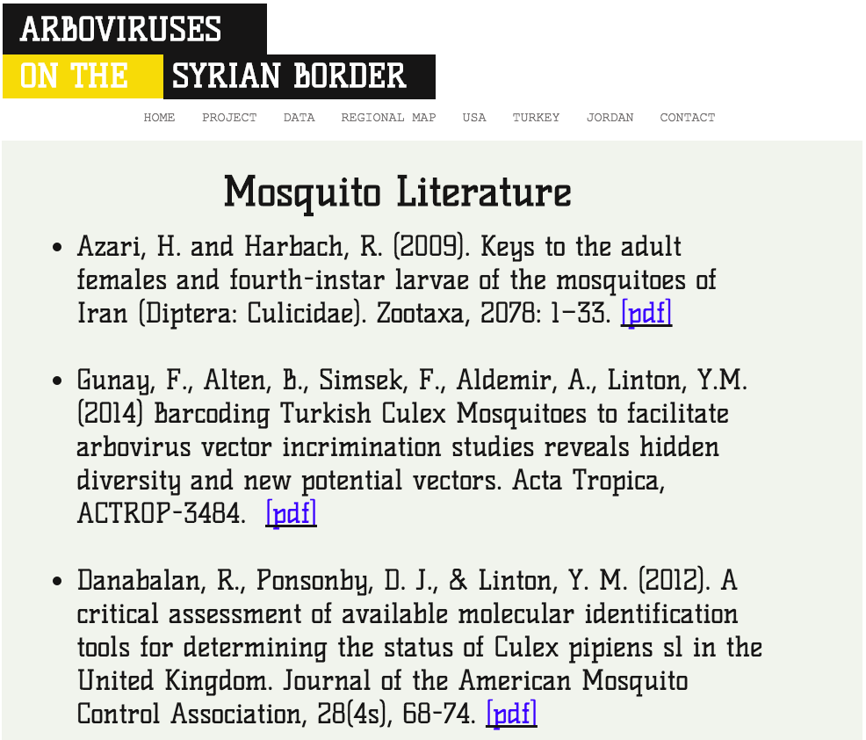
Project focus – Prerequisite data

Slide 7
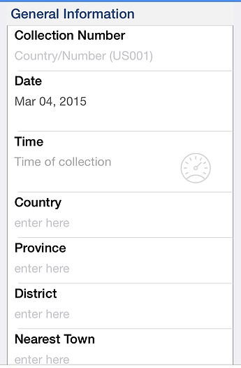
Project focus – Field Collections
The Field data Submission form (FDS) is an app designed for use in the field, on computers, smart phones or tablets of all types and simplifies the collection process with drop-down menus and a simplified layout.
The form includes a button that allows GPS co-ordinates, detailed mapping and location information, as well as the ability to take and annotate pictures of the collection site.

Slide 8
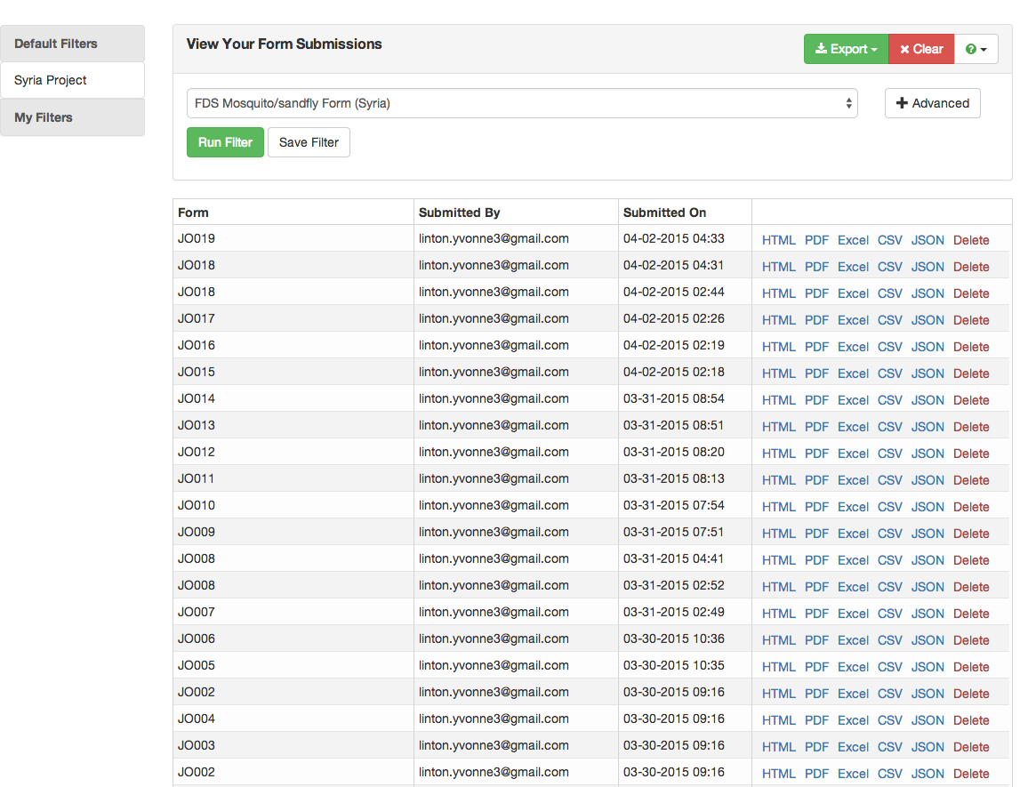
Project focus – Data Management
As soon as the form is submitted (via a button on the form) the information is sent over the internet or mobile network, and is accessible by the information manager or users by permission, for processing.
If no internet is available at the time of collection, data will be saved and sent when possible.

Slide 9
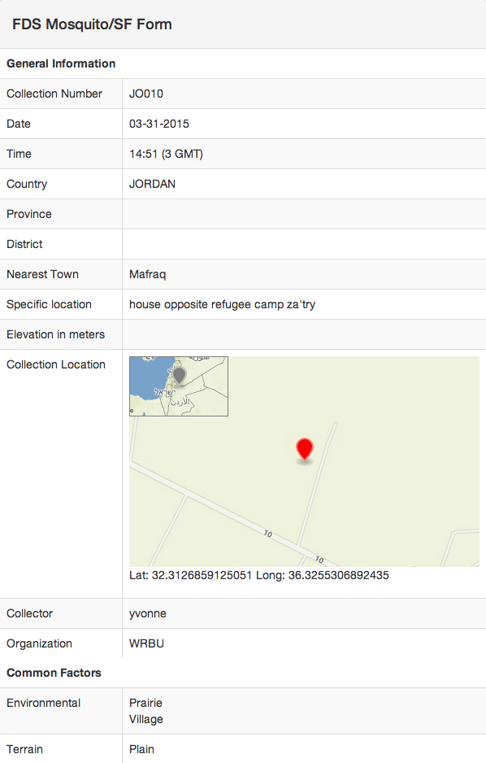
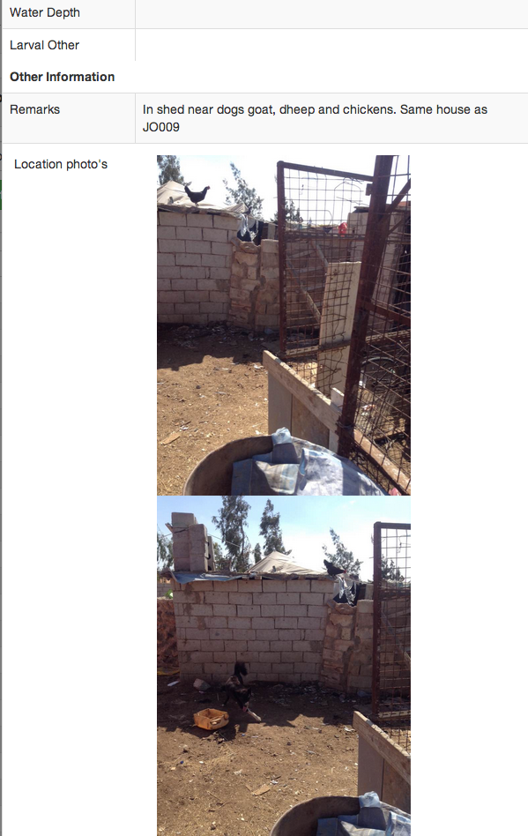
Project focus – Data Management
Each record can be viewed online or downloaded as a PDF document. This includes a map-in-map with co-ordinates and any pictures taken with the collection.
All records can also be downloaded to an Excel Spreadsheet either individually or en-mass, depending on filters applied (e.g. by country, date or collector)

Slide 10
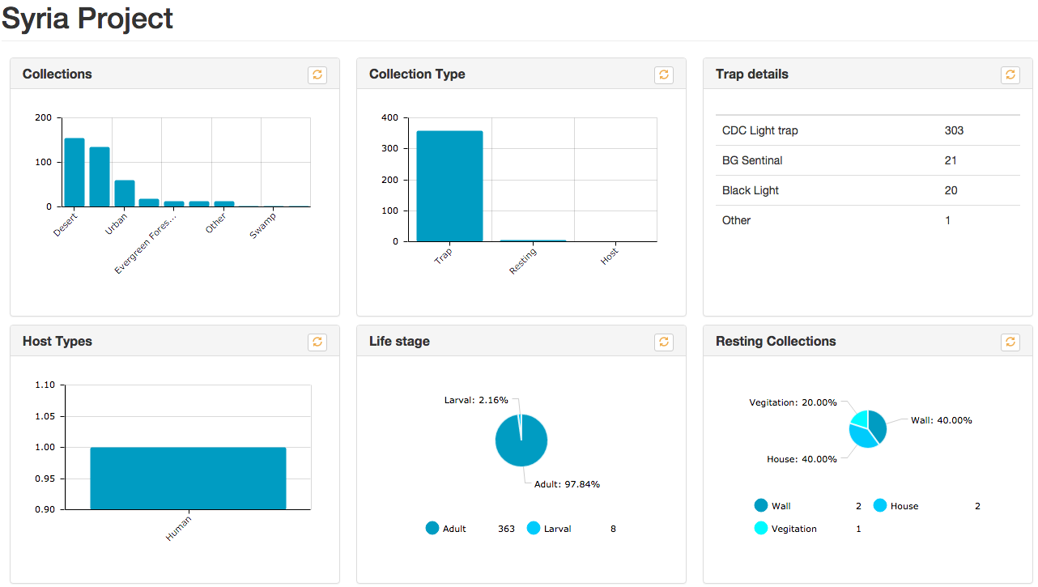
Project focus – Data Management

Slide 11
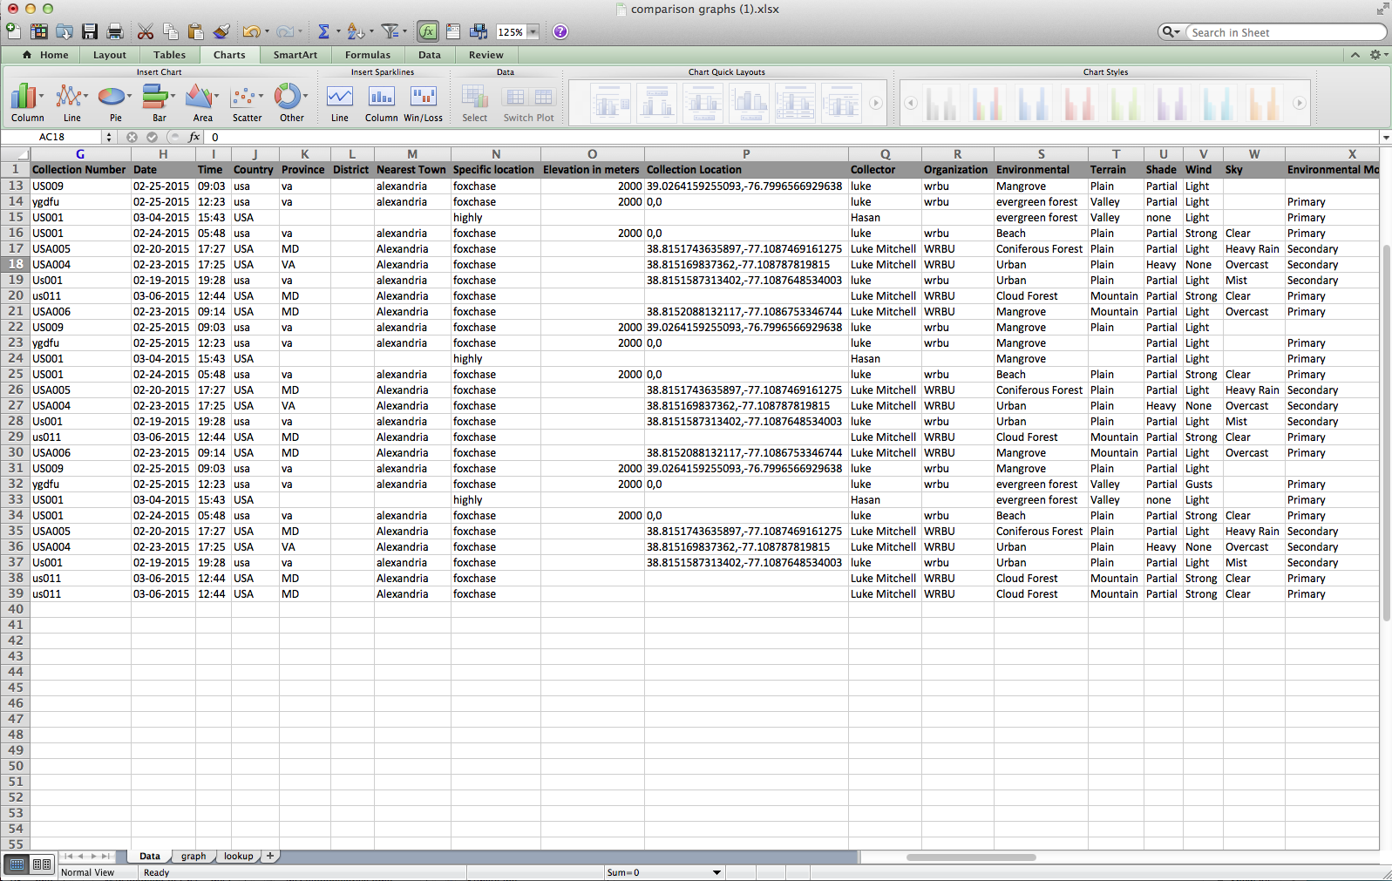
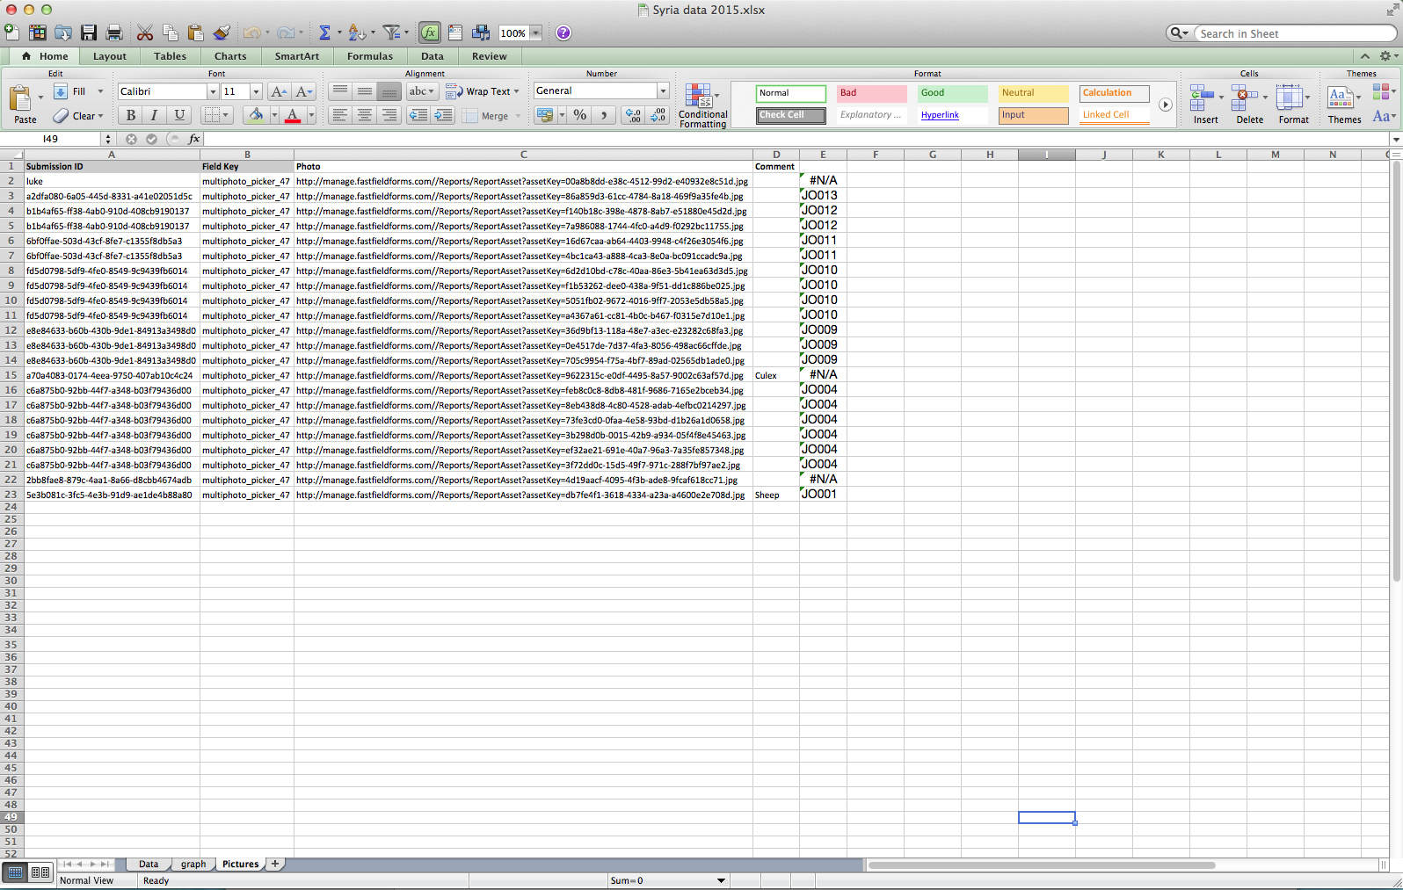
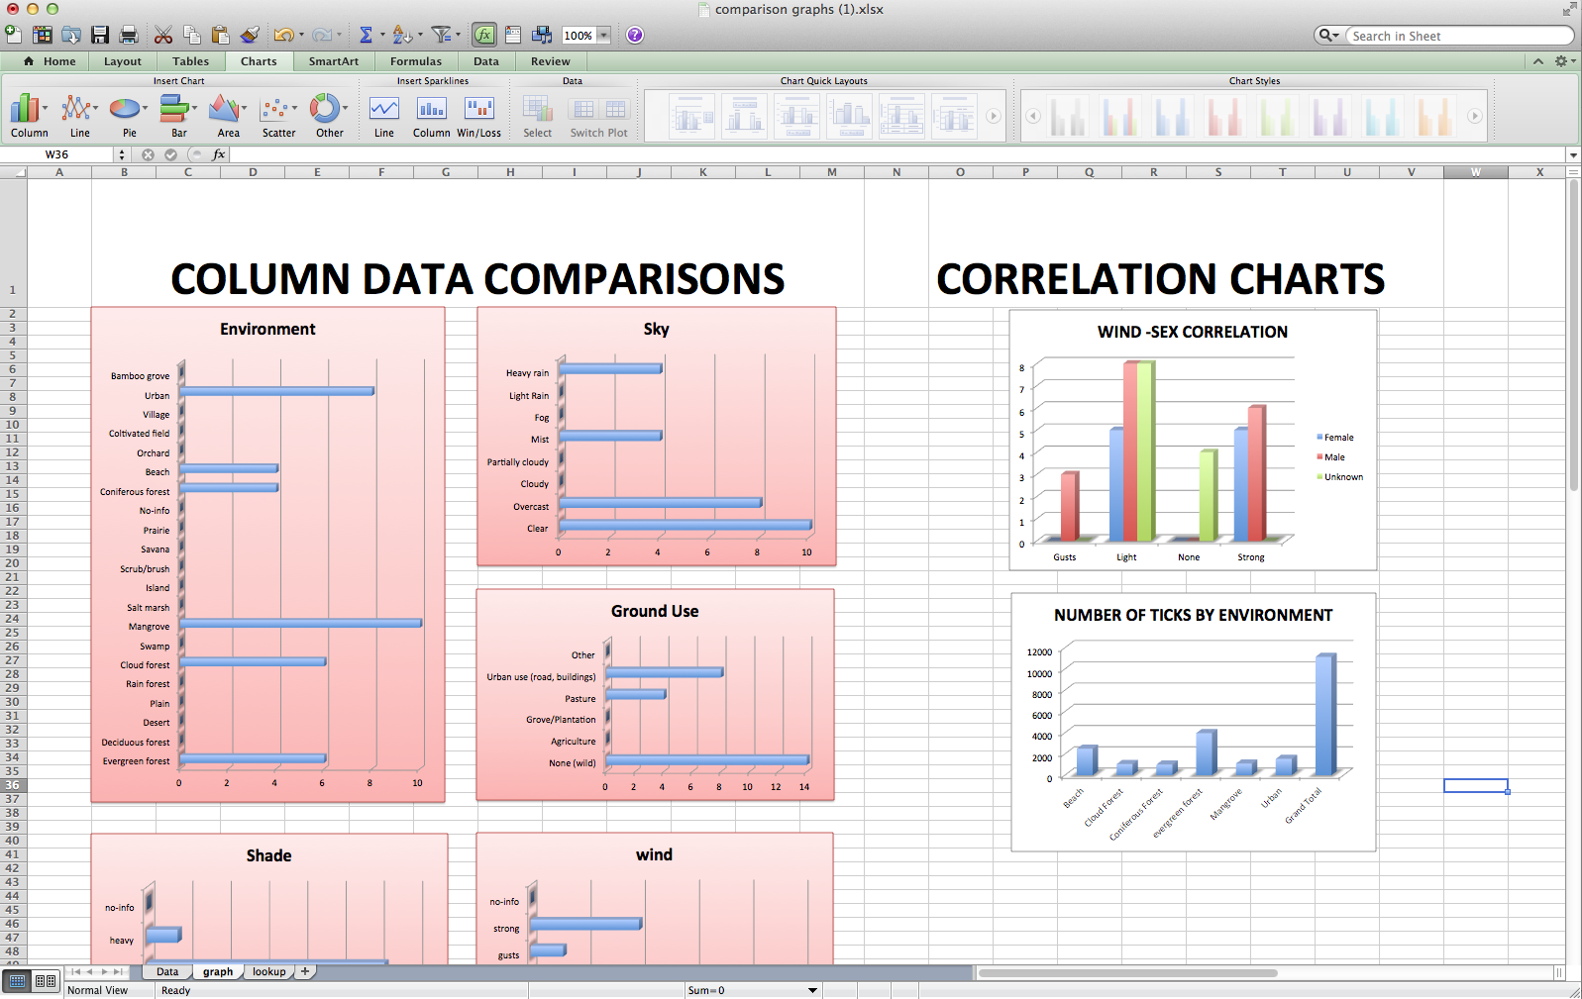
Project focus – Data Management
The data manager exports to an Excel Spreadsheet which automatically creates a number of sheets for differing information.
Sheet 1: Collection Data
Sheet 2: Picture Links
Sheet 3: Graphs

Slide 12
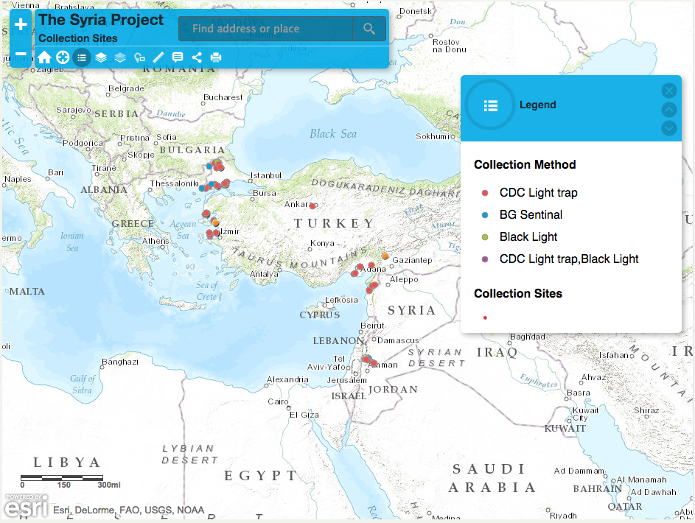
Project focus – Data Management
A service on the website provided by VectorMap is the project specific mapping.

Slide 13
FDS Summary
No certification issues for civilian collections.
Collections of Sand Flies and Mosquitoes in Turkey and Jordan ongoing.
Testing conducted within 2 universities in the US for Ticks.
Available for static collections with forms for “set-up” and “collection”
Adaptable for almost any biosurveillence activities and allows submission directly to VM.

Slide 14
What next?
Continuous testing and development.
GEIS proposal submitted.
Available to all GEIS partners at basic cost.
Encourage a STANDARD DATA PROCESS.

Slide 15
Questions?

